Slide 1
Classification of the Music Genre
Bo-Hun Kim, Min-Sik Park, and Soo-Yeon Han
Pattern Recognition
June 14, 2017

Slide 2
Introduction
Goal
Classifying the music genres from features of music/audio data extracted by Mel-Frequency Cepstral Coefficient (MFCC)
Motivation
Most inputs of the generation model with machine learning topics have focused Nature language processing(NLP) or Computer Vision
On the other hand, we are going to do a project on audio / music data field which is relatively less studied.
Notes:
머신러닝/딥러닝이 각광받고 있는데 주로 적용되는 분야가 이미지 분석/텍스트 분석에 관한 것들이다.
그에 비해 상대적으로 덜 주목 받고 있는 오디오/음악 데이터 분야에 대한 프로젝트를 진행해보려고 한다.
이번 프로젝트에서는 음악(mp3, wav)파일로부터 특징값(spectrogram/MFCC)를 추출한 후 이를 바탕으로 해당 음악파일의 장르를 머신 러닝 알고리즘을 적용하여 분류하는 프로젝트를 시도해보았다.

Slide 3
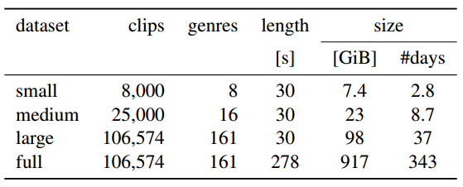
Methods (1/9)
Dataset
Using the FMA (Free Music Archive) dataset
An open and easily accessible dataset
Set sizes
Genres of ‘Small dataset’
1. Electronic
2. Experimental
3. Folk
4. Hip-Hop
5. Instrumental : Perform by instruments and not by voices
6. International : traditional music, work songs, oral traditions,…
7. Pop
8. Rock

Slide 4
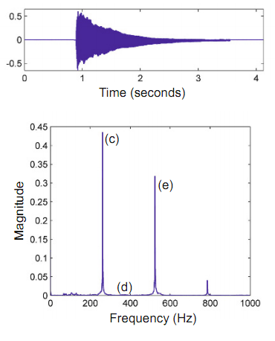
Methods (2/9)
Pre-processing
Waveform shape data is difficult to analyze the features
Using the Fourier transform to convert time-domain to Frequency-domain
To know which frequency component is dominant
Fourier transform
Time domain
Frequency domain
Notes:
음원 데이터(mp3, wav) 파일은 시간 단위로 높고 낮음으로 표현한 파형(waveform)으로 나타낼 수 있다.
waveform 형태는 시간에 따른 변화를 파악하기에는 용이하지만 특정 시간에서 어떠한 성분(주파수)이 영향력이 큰지 파악하기 어렵다.
Time-domain 형태인 Frequency-domain으로 변환해주는 푸리에 변환을 이용하면 어떠한 주파수가 소리를 내는데 영향력을 끼치고 있는지 파악할 수 있다.
(높은 음일수록 주파수가 높고, 낮은 음일수록 주파수가 낮음)

Slide 5
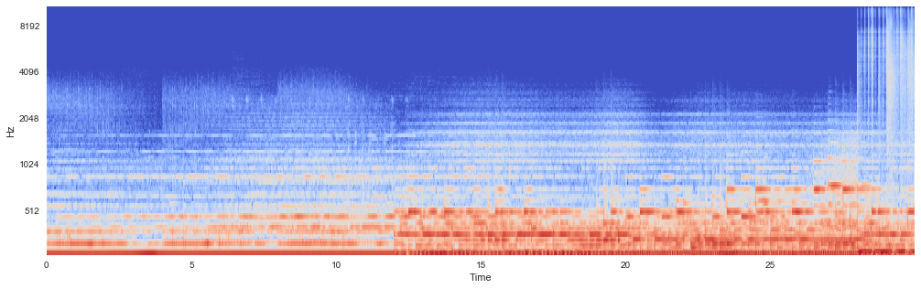
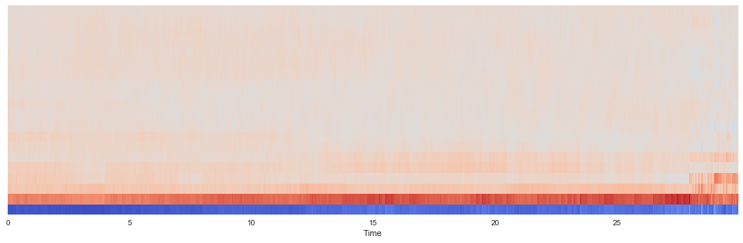
Methods (3/9)
Pre-processing
STFT(Short Time Fourier Transform) : Fourier transform for every short time
MFCC(Mel Frequency Cepstral Coefficient) : Features capture timbral properties of the signal. Most common representation used in automatic speech recognition and genre classification and audio similarity measures, etc.
Spectrogram
MFCC
Notes:
기본적인 Fourier transform은 시간을 고려하지 않기 때문에 시간 단위로 주파수를 고려하려면 일정 구간을 단위로 Fourier transform을 수행해주는 short time Fourier Transform이 필요하다
STFT(short time fourier transform)을 통하여 시간기준으로 주파수의 높고 낮음을 확인할 수 있는 Spectrogram을 생성할 수 있다.
MFCC : speaker recognition에 주로 사용. 음성인식 분야/음악 데이터에서의 장르 분류에 많이 쓰이고 있는 특징값이다.
입력된 신호에서 노이즈 및 배경 소리로 부터 실제 유효한 소리의 특징을 추출. Short time의 power spectrum에서 분석. 사람이 실제로 소리를 느끼는 것은 dB(log) 단위이므로 Mel-scale로 변환한 power spectrum을 이용하는 것. (푸리에^2 -> 로그 -> DCT.)
Filter bank는 일반적으로 26개.

Slide 6

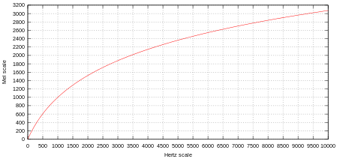


Methods (4/9)
Pre-processing
MFCC(Mel Frequency Cepstral Coefficient) :
ST Fourier transform (domain을 주파수로)
Mel – scale (log scale로 변환)
DCT (energy correlation 분리)

Slide 7
Methods (5/9)
Process of a dataset for analysis
Extract MFCC from audio signal data
Calculate mean, median, standard deviation, maximum, minimum, kurtosis, skewness, and other statistics.
The above data were classified by applying a machine learning / pattern recognition models. : k-fold cross validation, test data result measuring by accuracy, precision, recall, F1-measure
Input : MFCC statics
Output (label) : genre
Notes:
본 프로젝트에서는 MFCC를 추출한 후 각 MFCC 벡터들의 평균, 중위수, 표준편차, 최대값, 최소값, 첨도(kurtosis), 왜도(skewness)와 같은 통계량을 추출한 후
이를 입력데이터로 하고, 각 음원별 장르 label을 출력데이터로 하여 기계학습/패턴인식 모델을 적용하여 분류를 실시하였다.

Slide 8
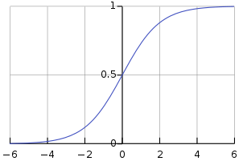
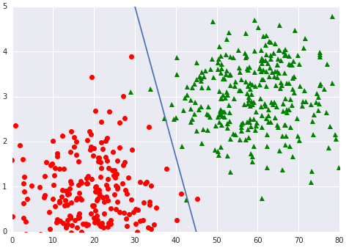
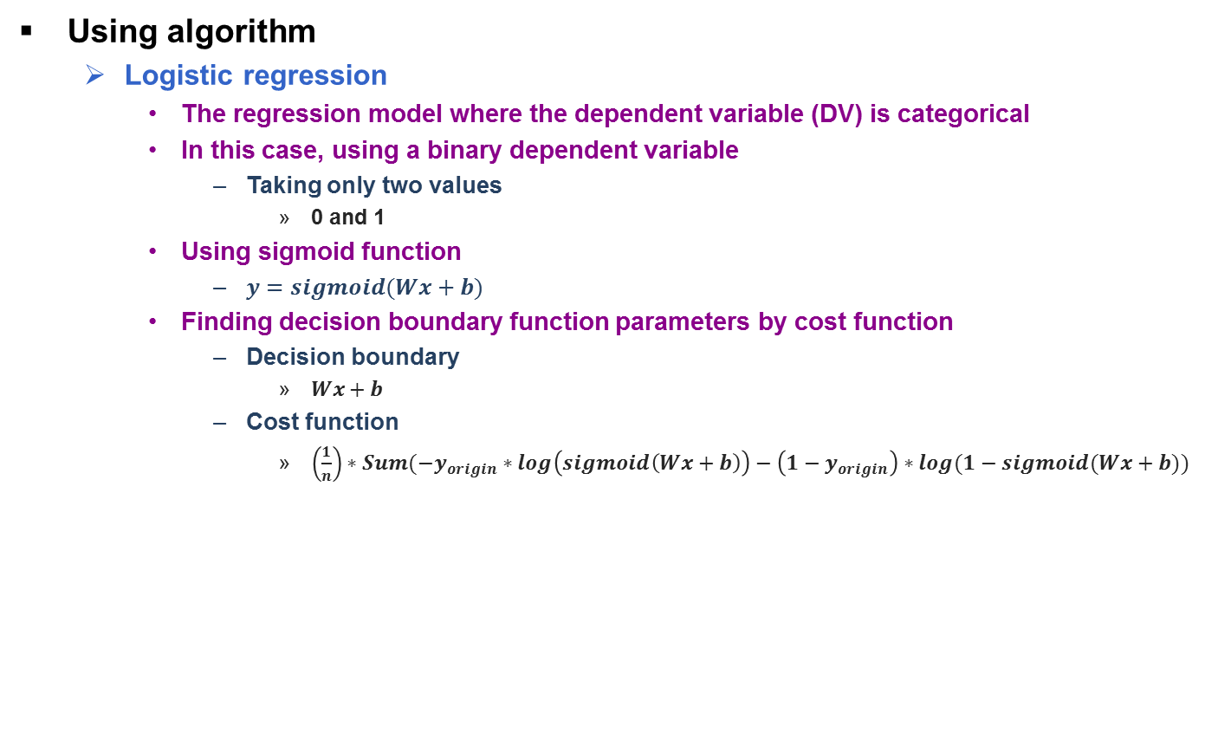
Methods (6/9)
Using algorithm
Logistic regression
The regression model where the dependent variable (DV) is categorical
In this case, using a binary dependent variable
Taking only two values
0 and 1
Using sigmoid function
$y=sigmoid(Wx+b)$
Finding decision boundary function parameters by cost function
Decision boundary
$Wx+b$
Cost function
$\left(\frac{1}{n}\right)∗Sum(−y_{origin}∗log\left(sigmoid\left(Wx+b\right)\right)−\left(1−y_{origin}\right)∗log(1−sigmoid(Wx+b))$
Sigmoid kernel function
Boundary function for 2-class classification
Notes:
http://bcho.tistory.com/1142#recentTrackback

Slide 9
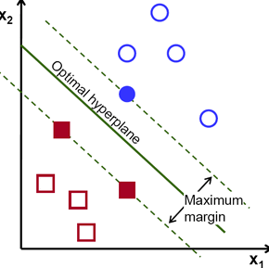
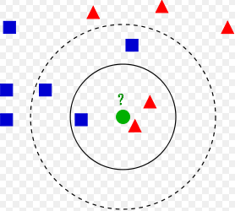
Methods (7/9)
K-Nearest Neighbor (KNN) classifier
A non-parametric method used for classification
The output
A class membership
A classifier of forming separate clusters in the feature space by the location of the neighbors
The close neighbors belong to the same class
Classification of an object by a majority vote of its neighbors, with the object being assigned to the class most common among its K nearest neighbors
Support Vector Machine (SVM)
Constructing a hyperplane to separate the feature vectors into several classes maximizing the distance between the nearest training samples and the hyperplanes
Example of K-NN classification
Example of SVM classification
Notes:
Example of k-NN classification. The test sample (green circle) should be classified either to the first class of blue squares or to the second class of red triangles. If k = 3 (solid line circle) it is assigned to the second class because there are 2 triangles and only 1 square inside the inner circle. If k = 5 (dashed line circle) it is assigned to the first class (3 squares vs. 2 triangles inside the outer circle).

Slide 10
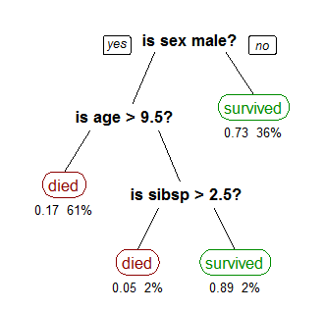
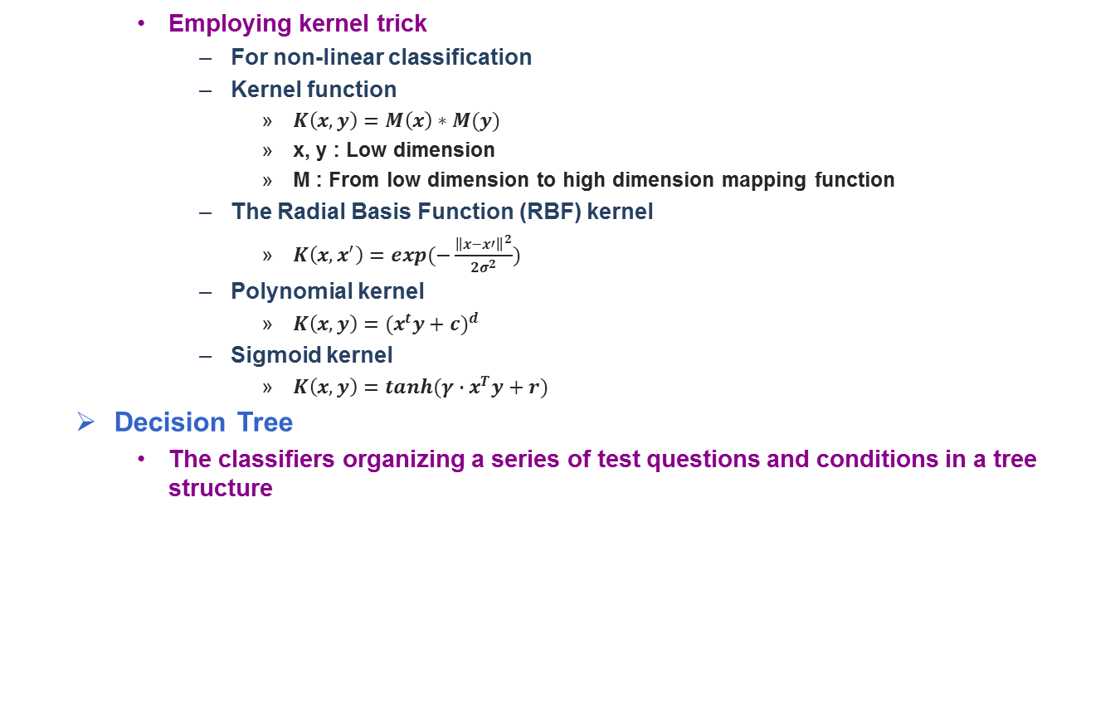
Methods (8/9)
Employing kernel trick
For non-linear classification
Kernel function
$K\left(x,y\right)=M\left(x\right)∗M(y)$
x, y : Low dimension
M : From low dimension to high dimension mapping function
The Radial Basis Function (RBF) kernel
$K\left(x,x^{′}\right)=exp(−\frac{{\left\|x−x′\right\|}^{2}}{2σ^{2}})$
Polynomial kernel
$K\left(x,y\right)={(x^{t}y+c)}^{d}$
Sigmoid kernel
$K\left(x,y\right)=tanh(γ∙x^{T}y+r)$
Decision Tree
The classifiers organizing a series of test questions and conditions in a tree structure
A tree showing survival of passengers on the Titanic
Notes:
https://en.wikipedia.org/wiki/Polynomial_kernel
커널트릭: 비선형 분류를 하기 위해 저차원에서 고차원 특징 공간으로 사상
A tree showing survival of passengers on the Titanic ("sibsp" is the number of spouses or siblings aboard). The figures under the leaves show the probability of survival and the percentage of observations in the leaf.

Slide 11
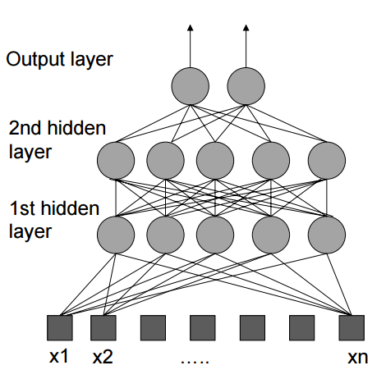
Methods (9/9)
Ensemble models (Random Forest, AdaBoost)
Using multiple learning algorithms to obtain better predictive performance than could be obtained from any of the constituent learning algorithms alone
Making N-decision tree by randomly sampling observations and features
Gaining the high performance model by voting each classification models
Multi-Layer Perceptron (MLP)
Propagating from the inputs to the outputs
Weights randomly initialized
Multiplying inputs with weights and passing through activation function
Activation function : ReLU, Optimizer : Adam
After comparing the output and ground truth, computing modified weights by backpropagation
Repeated until reach to stop-condition
MLP process
Notes:
http://blog.heartcount.io/random-forest-ver-10
Weights between input and layer, layer and layer, layer and output randomly initialized

Slide 12
Results
Logistic regression
Confusion matrix
Accuracy rate : 0.42
 | Electronic | Experimental | Folk | Hip-Hop | Instrumental | International | Pop | Rock
Electronic | 55 | 3 | 3 | 13 | 2 | 10 | 11 | 3
Experimental | 9 | 24 | 11 | 4 | 19 | 11 | 13 | 9
Folk | 2 | 17 | 15 | 0 | 6 | 27 | 24 | 9
Hip-Hop | 13 | 3 | 2 | 70 | 2 | 7 | 1 | 2
Instrumental | 6 | 11 | 24 | 4 | 43 | 0 | 4 | 8
International | 9 | 4 | 19 | 12 | 3 | 43 | 7 | 3
Pop | 21 | 3 | 10 | 14 | 5 | 12 | 23 | 12
Rock | 1 | 10 | 5 | 0 | 5 | 4 | 10 | 65
 | Precision | Recall | F1-score
Electronic | 0.47 | 0.55 | 0.51
Experimental | 0.32 | 0.24 | 0.27
Folk | 0.17 | 0.15 | 0.16
Hip-Hop | 0.60 | 0.70 | 0.65
Instrumental | 0.51 | 0.43 | 0.46
International | 0.38 | 0.43 | 0.40
Pop | 0.25 | 0.23 | 0.24
Rock | 0.59 | 0.65 | 0.62
Avg/total | 0.41 | 0.42 | 0.41

Slide 13
Results
K-NN : # of neighbors 200
Confusion matrix
Accuracy rate : 0.37
 | Electronic | Experimental | Folk | Hip-Hop | Instrumental | International | Pop | Rock
Electronic | 20 | 0 | 4 | 50 | 3 | 11 | 4 | 8
Experimental | 2 | 1 | 28 | 14 | 29 | 9 | 7 | 10
Folk | 0 | 0 | 40 | 0 | 10 | 20 | 17 | 13
Hip-Hop | 11 | 0 | 3 | 68 | 4 | 2 | 5 | 7
Instrumental | 0 | 3 | 47 | 2 | 37 | 7 | 3 | 1
International | 0 | 0 | 28 | 27 | 0 | 39 | 2 | 4
Pop | 3 | 0 | 11 | 43 | 2 | 12 | 21 | 8
Rock | 0 | 2 | 5 | 6 | 7 | 2 | 8 | 70
 | Precision | Recall | F1-score
Electronic | 0.56 | 0.20 | 0.29
Experimental | 0.17 | 0.01 | 0.02
Folk | 0.24 | 0.40 | 0.30
Hip-Hop | 0.32 | 0.68 | 0.44
Instrumental | 0.40 | 0.37 | 0.39
International | 0.38 | 0.39 | 0.39
Pop | 0.31 | 0.21 | 0.25
Rock | 0.58 | 0.70 | 0.63
Avg/total | 0.37 | 0.37 | 0.34

Slide 14
Results
SVM (RBF kernel)
Confusion matrix
Accuracy rate : 0.47
 | Electronic | Experimental | Folk | Hip-Hop | Instrumental | International | Pop | Rock
Electronic | 58 | 3 | 1 | 13 | 5 | 5 | 6 | 6
Experimental | 14 | 37 | 8 | 3 | 21 | 8 | 3 | 6
Folk | 4 | 16 | 22 | 0 | 8 | 34 | 6 | 10
Hip-Hop | 12 | 2 | 2 | 72 | 3 | 3 | 3 | 3
Instrumental | 2 | 13 | 23 | 3 | 50 | 2 | 4 | 3
International | 11 | 0 | 20 | 14 | 0 | 53 | 0 | 2
Pop | 21 | 8 | 14 | 16 | 1 | 11 | 16 | 13
Rock | 1 | 8 | 9 | 3 | 5 | 1 | 5 | 68
 | Precision | Recall | F1-score
Electronic | 0.47 | 0.58 | 0.52
Experimental | 0.41 | 0.37 | 0.39
Folk | 0.22 | 0.22 | 0.22
Hip-Hop | 0.58 | 0.72 | 0.64
Instrumental | 0.54 | 0.50 | 0.52
International | 0.45 | 0.53 | 0.49
Pop | 0.37 | 0.16 | 0.22
Rock | 0.61 | 0.68 | 0.64
Avg/total | 0.46 | 0.47 | 0.46

Slide 15
Results
SVM (Linear kernel)
Confusion matrix
Accuracy rate : 0.43
 | Electronic | Experimental | Folk | Hip-Hop | Instrumental | International | Pop | Rock
Electronic | 57 | 1 | 2 | 16 | 4 | 4 | 8 | 8
Experimental | 11 | 14 | 14 | 5 | 27 | 11 | 9 | 9
Folk | 3 | 10 | 18 | 0 | 9 | 39 | 9 | 12
Hip-Hop | 10 | 1 | 2 | 69 | 2 | 8 | 6 | 2
Instrumental | 6 | 6 | 25 | 3 | 48 | 2 | 2 | 8
International | 11 | 2 | 19 | 9 | 5 | 43 | 9 | 2
Pop | 16 | 4 | 11 | 15 | 4 | 10 | 23 | 17
Rock | 2 | 3 | 9 | 2 | 5 | 2 | 5 | 72
 | Precision | Recall | F1-score
Electronic | 0.49 | 0.57 | 0.53
Experimental | 0.34 | 0.14 | 0.20
Folk | 0.18 | 0.18 | 0.18
Hip-Hop | 0.58 | 0.69 | 0.63
Instrumental | 0.46 | 0.48 | 0.47
International | 0.36 | 0.43 | 0.39
Pop | 0.32 | 0.23 | 0.27
Rock | 0.55 | 0.72 | 0.63
Avg/total | 0.41 | 0.43 | 0.41

Slide 16
Results
SVM (Polynomial kernel) : degree 5
Confusion matrix
Accuracy rate : 0.43
 | Electronic | Experimental | Folk | Hip-Hop | Instrumental | International | Pop | Rock
Electronic | 55 | 5 | 0 | 19 | 6 | 4 | 3 | 8
Experimental | 14 | 21 | 7 | 2 | 34 | 7 | 8 | 7
Folk | 0 | 13 | 25 | 0 | 16 | 23 | 12 | 11
Hip-Hop | 12 | 0 | 2 | 70 | 3 | 4 | 4 | 5
Instrumental | 3 | 9 | 23 | 2 | 52 | 2 | 4 | 5
International | 11 | 1 | 22 | 9 | 3 | 41 | 6 | 7
Pop | 27 | 5 | 10 | 19 | 4 | 7 | 12 | 16
Rock | 3 | 3 | 5 | 5 | 10 | 2 | 3 | 69
 | Precision | Recall | F1-score
Electronic | 0.48 | 0.40 | 0.44
Experimental | 0.31 | 0.12 | 0.17
Folk | 0.22 | 0.24 | 0.23
Hip-Hop | 0.54 | 0.72 | 0.62
Instrumental | 0.39 | 0.49 | 0.44
International | 0.36 | 0.40 | 0.38
Pop | 0.30 | 0.21 | 0.25
Rock | 0.51 | 0.67 | 0.58
Avg/total | 0.39 | 0.41 | 0.39

Slide 17
Results
Decision trees : max_depth 5
Confusion matrix
Accuracy rate : 0.345
 | Electronic | Experimental | Folk | Hip-Hop | Instrumental | International | Pop | Rock
Electronic | 37 | 5 | 7 | 23 | 5 | 5 | 9 | 9
Experimental | 18 | 16 | 15 | 4 | 20 | 11 | 9 | 7
Folk | 0 | 15 | 30 | 0 | 6 | 33 | 7 | 9
Hip-Hop | 22 | 6 | 1 | 49 | 3 | 5 | 13 | 1
Instrumental | 7 | 8 | 18 | 2 | 46 | 2 | 7 | 10
International | 8 | 4 | 21 | 10 | 8 | 28 | 13 | 8
Pop | 21 | 6 | 13 | 15 | 6 | 8 | 25 | 6
Rock | 7 | 11 | 11 | 3 | 8 | 5 | 10 | 45
 | Precision | Recall | F1-score
Electronic | 0.31 | 0.37 | 0.34
Experimental | 0.23 | 0.16 | 0.19
Folk | 0.26 | 0.30 | 0.28
Hip-Hop | 0.46 | 0.49 | 0.48
Instrumental | 0.45 | 0.46 | 0.46
International | 0.29 | 0.28 | 0.28
Pop | 0.27 | 0.25 | 0.26
Rock | 0.47 | 0.45 | 0.46
Avg/total | 0.34 | 0.34 | 0.34

Slide 18
Results
Ensemble model(Random Forest) : max depth 5, # of estimators 10
Confusion matrix
Accuracy rate : 0.35
 | Electronic | Experimental | Folk | Hip-Hop | Instrumental | International | Pop | Rock
Electronic | 39 | 5 | 3 | 30 | 4 | 10 | 2 | 7
Experimental | 10 | 19 | 21 | 5 | 15 | 13 | 4 | 13
Folk | 0 | 9 | 26 | 0 | 28 | 15 | 12 | 10
Hip-Hop | 14 | 2 | 2 | 64 | 1 | 6 | 3 | 8
Instrumental | 2 | 15 | 42 | 1 | 32 | 5 | 2 | 1
International | 8 | 3 | 26 | 15 | 6 | 25 | 6 | 11
Pop | 10 | 1 | 13 | 34 | 6 | 17 | 10 | 9
Rock | 2 | 9 | 6 | 3 | 4 | 3 | 5 | 68
 | Precision | Recall | F1-score
Electronic | 0.46 | 0.39 | 0.42
Experimental | 0.30 | 0.19 | 0.23
Folk | 0.19 | 0.26 | 0.22
Hip-Hop | 0.42 | 0.64 | 0.51
Instrumental | 0.33 | 0.32 | 0.33
International | 0.27 | 0.25 | 0.26
Pop | 0.23 | 0.10 | 0.14
Rock | 0.54 | 0.68 | 0.60
Avg/total | 0.34 | 0.35 | 0.34

Slide 19
Results
Ensemble model(AdaBoost) : # of estimators 10
Confusion matrix
Accuracy rate : 0.37
 | Electronic | Experimental | Folk | Hip-Hop | Instrumental | International | Pop | Rock
Electronic | 40 | 2 | 5 | 23 | 6 | 7 | 9 | 8
Experimental | 10 | 16 | 20 | 5 | 22 | 9 | 9 | 9
Folk | 1 | 12 | 30 | 0 | 6 | 39 | 4 | 8
Hip-Hop | 25 | 2 | 2 | 53 | 3 | 7 | 4 | 4
Instrumental | 1 | 11 | 21 | 4 | 55 | 4 | 2 | 2
International | 9 | 0 | 22 | 11 | 4 | 34 | 12 | 8
Pop | 22 | 2 | 14 | 16 | 9 | 8 | 19 | 10
Rock | 6 | 10 | 4 | 3 | 6 | 3 | 16 | 52
 | Precision | Recall | F1-score
Electronic | 0.35 | 0.40 | 0.37
Experimental | 0.29 | 0.16 | 0.21
Folk | 0.25 | 0.30 | 0.28
Hip-Hop | 0.46 | 0.53 | 0.49
Instrumental | 0.50 | 0.55 | 0.52
International | 0.31 | 0.34 | 0.32
Pop | 0.25 | 0.19 | 0.22
Rock | 0.51 | 0.52 | 0.52
Avg/total | 0.37 | 0.37 | 0.37

Slide 20
Results
Multilayer perceptron : 1 hidden layer, relu, adam optimizer
Confusion matrix
Accuracy rate : 0.43
 | Electronic | Experimental | Folk | Hip-Hop | Instrumental | International | Pop | Rock
Electronic | 53 | 7 | 2 | 10 | 3 | 5 | 14 | 6
Experimental | 11 | 36 | 9 | 4 | 20 | 7 | 8 | 5
Folk | 8 | 22 | 17 | 0 | 3 | 29 | 12 | 9
Hip-Hop | 11 | 6 | 4 | 66 | 2 | 4 | 5 | 2
Instrumental | 2 | 13 | 21 | 2 | 47 | 1 | 5 | 9
International | 9 | 3 | 14 | 10 | 4 | 55 | 4 | 1
Pop | 21 | 12 | 10 | 10 | 5 | 7 | 24 | 11
Rock | 1 | 15 | 10 | 4 | 4 | 1 | 16 | 49
 | Precision | Recall | F1-score
Electronic | 0.46 | 0.53 | 0.49
Experimental | 0.32 | 0.36 | 0.34
Folk | 0.20 | 0.17 | 0.18
Hip-Hop | 0.62 | 0.66 | 0.64
Instrumental | 0.53 | 0.47 | 0.50
International | 0.50 | 0.55 | 0.53
Pop | 0.27 | 0.24 | 0.26
Rock | 0.53 | 0.49 | 0.51
Avg/total | 0.43 | 0.43 | 0.43

Slide 21
Future works
Future works
Artist classification
Mood and Emotion Detection / Classification
Instrument Recognition and Classification
Singer Identification
Feature extraction use deep learning models(CNN/RNN, etc.) :

Slide 22
References
M. Defferrard, K. Benzi, P. Vandergheynst, and X. Bresson, “FMA: A Dataset for Music Analysis,” arXiv, 2017, pp. 1-8.
Tzanetakis, George, ed. Music data mining. CRC Press, 2011.
Müller, Meinard. Fundamentals of Music Processing: Audio, Analysis, Algorithms, Applications. Springer, 2015.
Lerch, Alexander. An introduction to audio content analysis: Applications in signal processing and music informatics. John Wiley & Sons, 2012.

